Slide 1
Snow depth monitoring using non-destructive imaging
Terrance Bariciak

Slide 2
Introduction
Snow depth is an important climate variable
Flood forecasting
Hydroelectric reservoir management
Habitat assessments
Methods
Manual ruler
Ultrasonic
Structure for Motion (UAV)
LIDAR

Slide 3
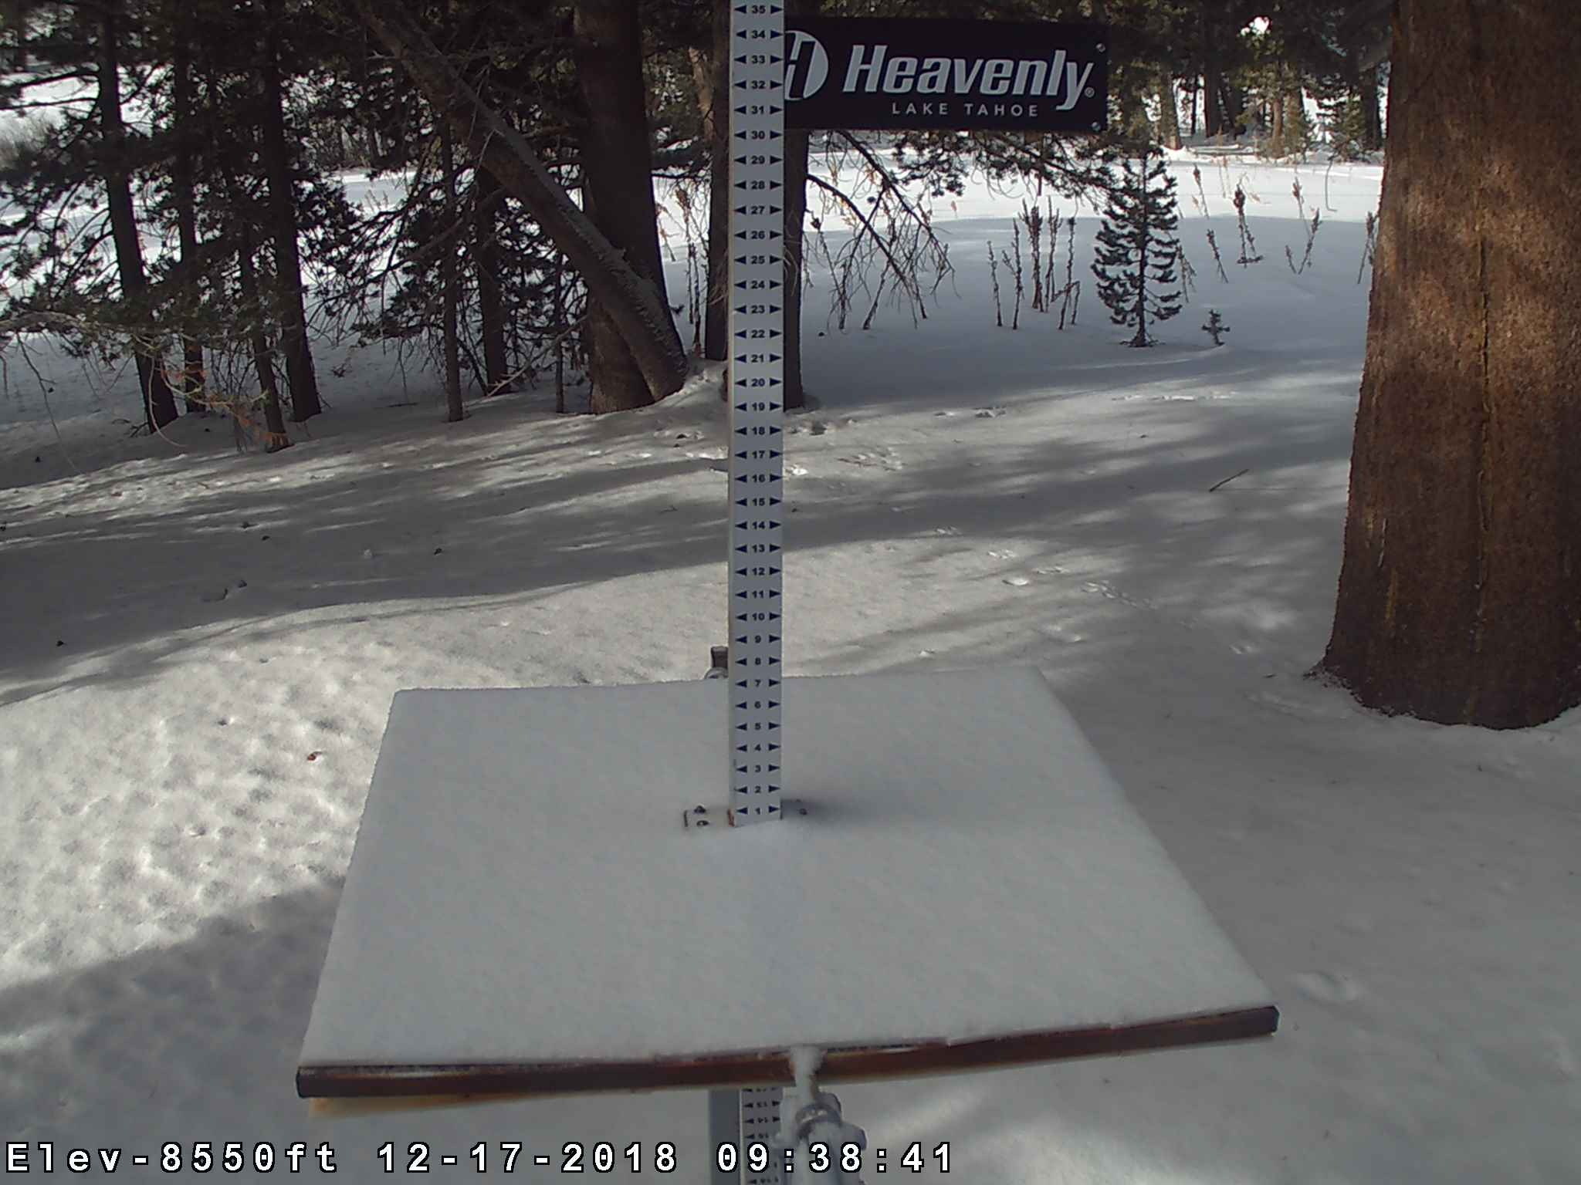
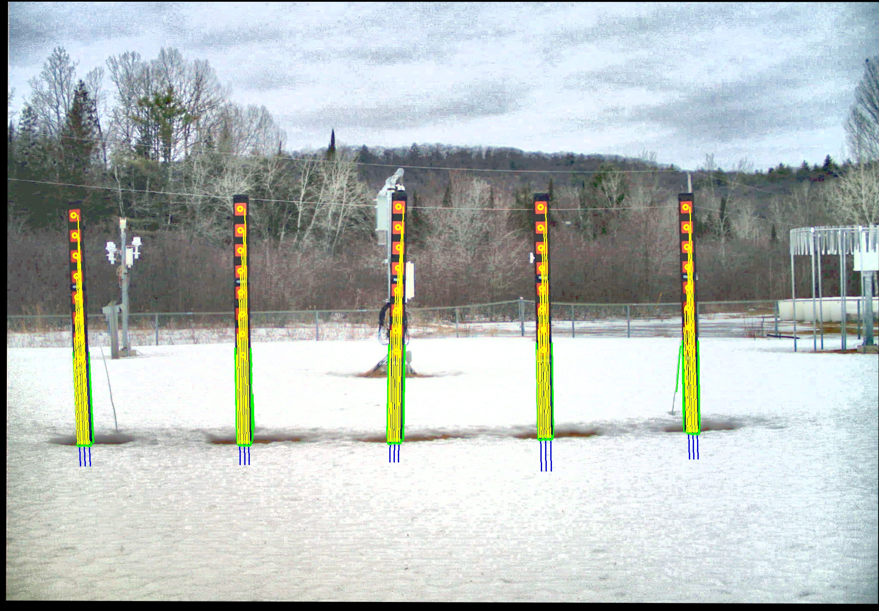
Concept – Web Camera Imagery
MANUAL RULER APPROACH
AUTOMATED STAKE APPROACH

Slide 4
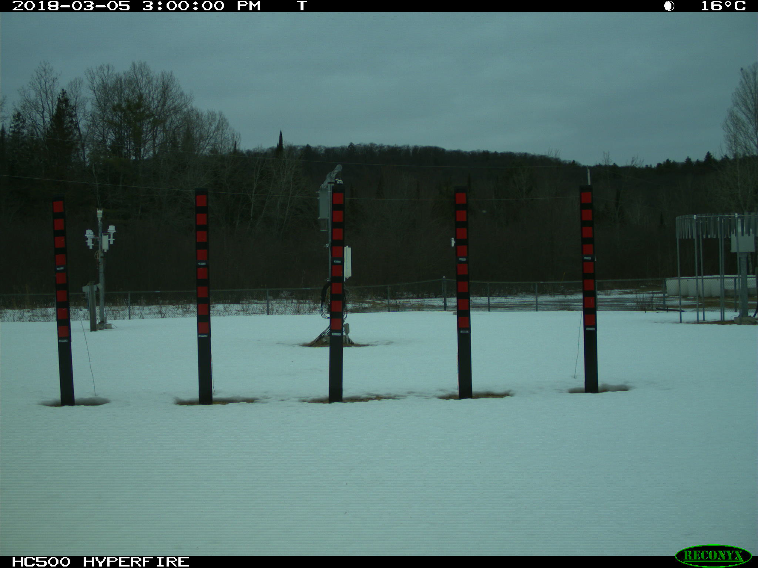
Automated Stake Approach
INPUT IMAGE
OUTPUT RESULT
Filter out night images
Equalize
Register to reference template
Verify individual stakes
Determine intersection
Calculate snow depth
Green circles: snow point on stake
Yellow lines: used as secondary measurement of snow depth

Slide 5
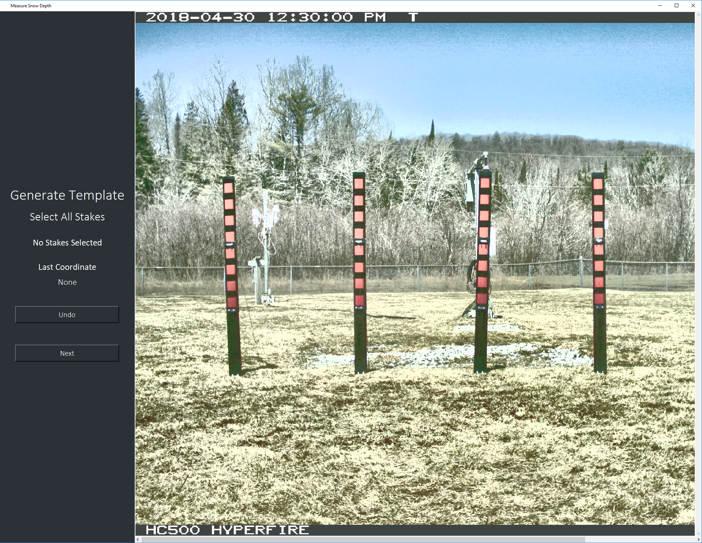
Reference Template
Template is required for snow depth measurement
Registration
Tensor (mm/pixel)
Stake verification (presence)
Minimum 2 red blobs
Selected by user
Can be snow/no snow
User defines stake and reference blob boundaries

Slide 6
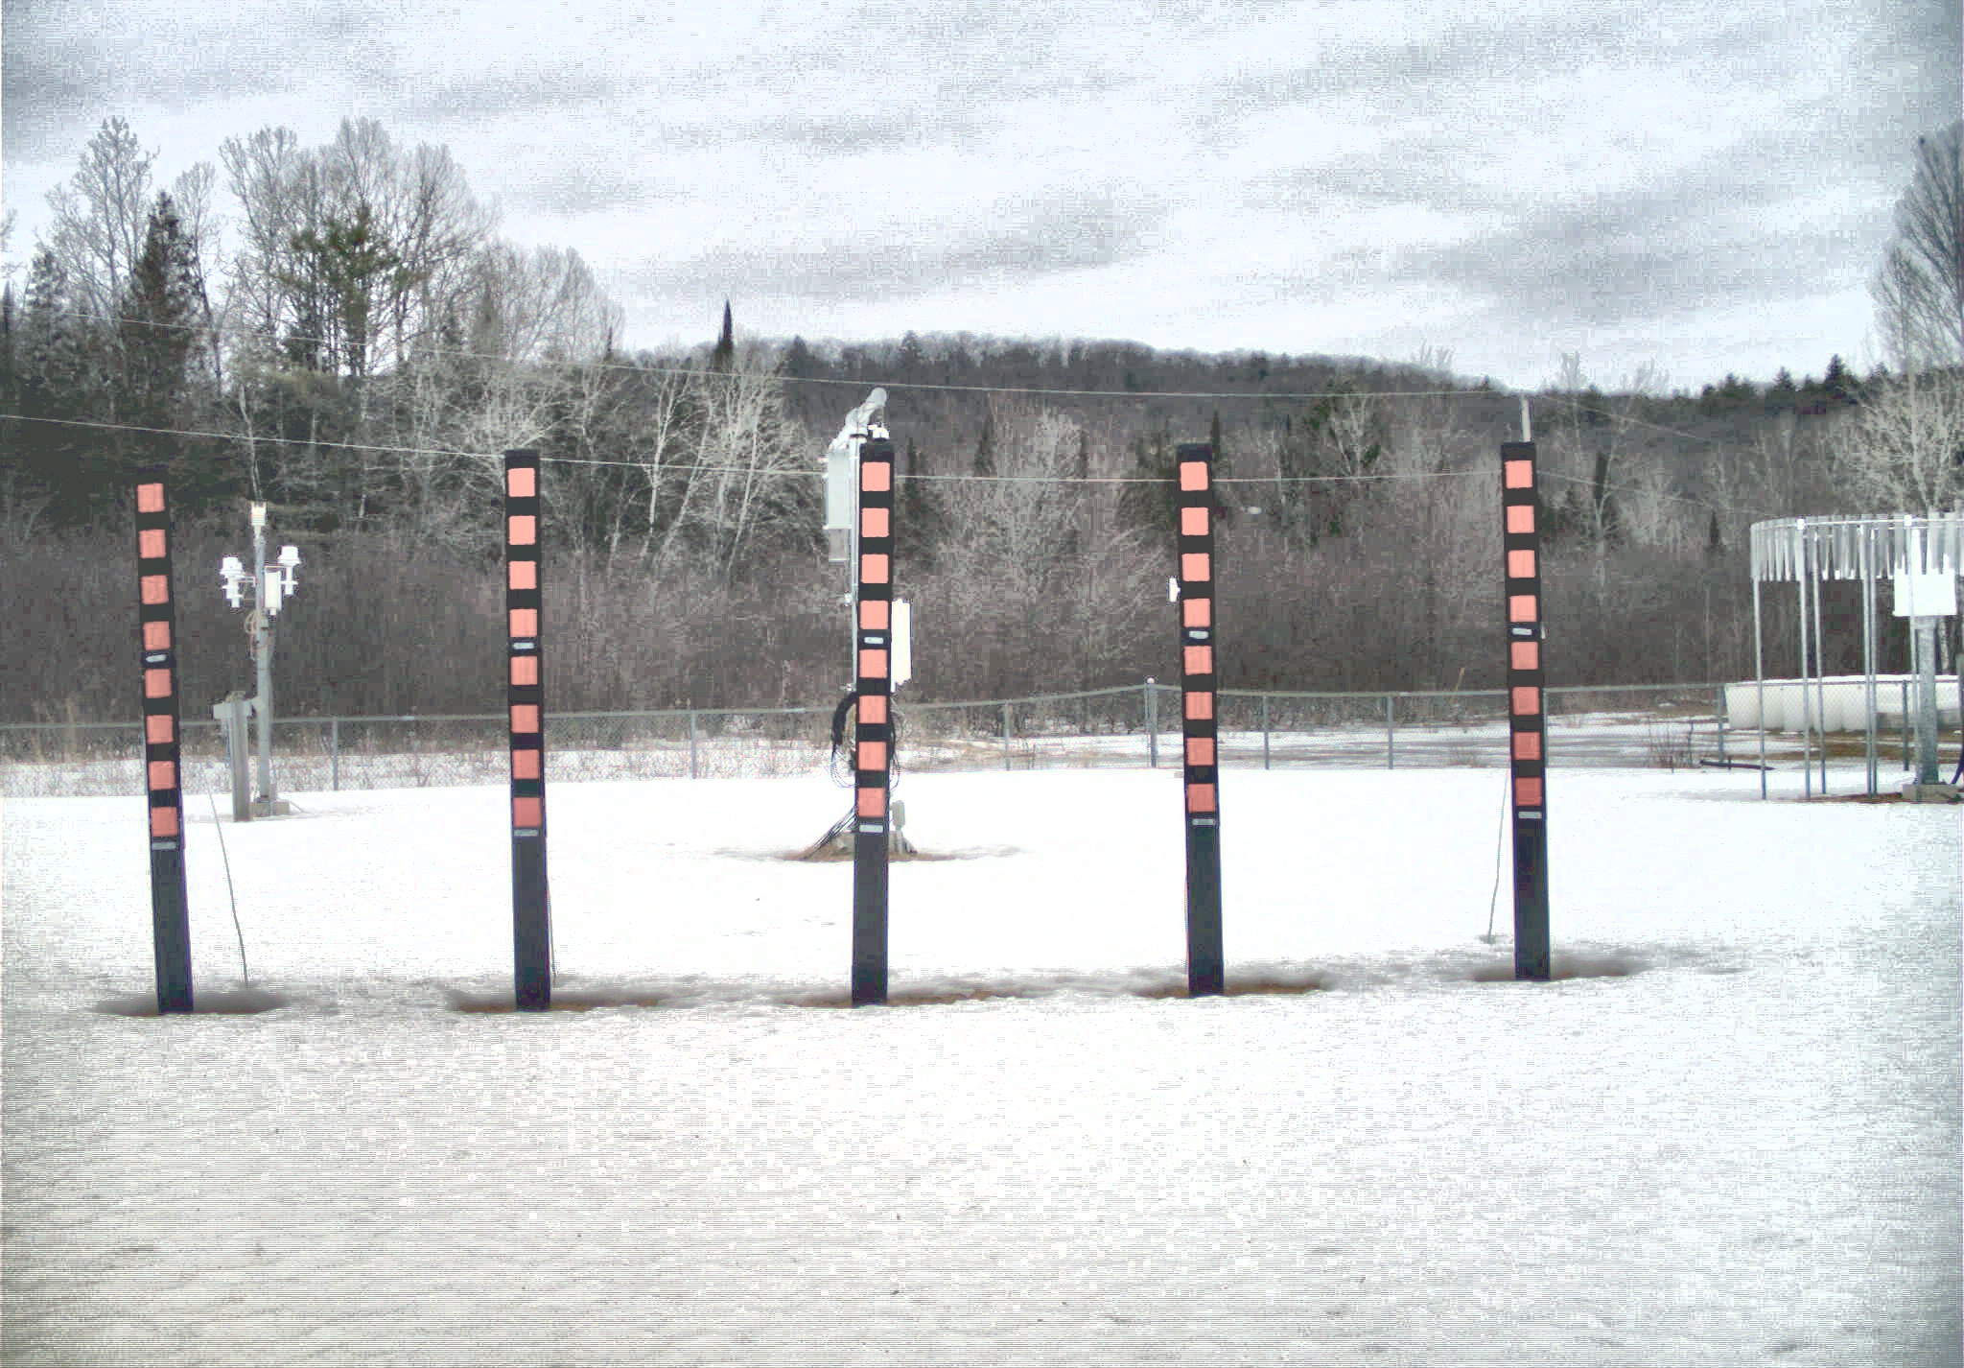
Filtering and Equalization

Slide 7
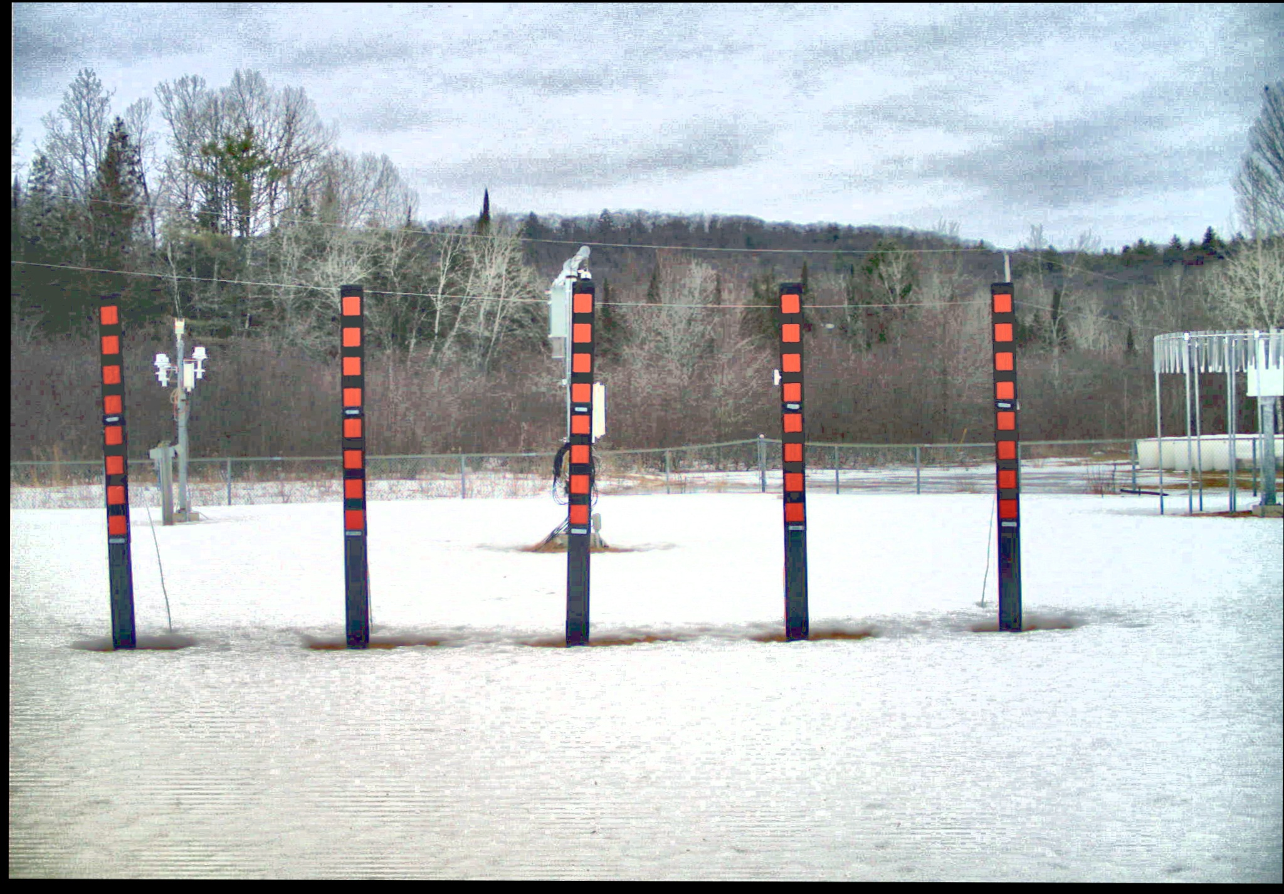
Registration
Input image is registered to reference template
Feature based (ORB)
Intensity Based (ECC)
Simplifies stake verification and intersection

Slide 8
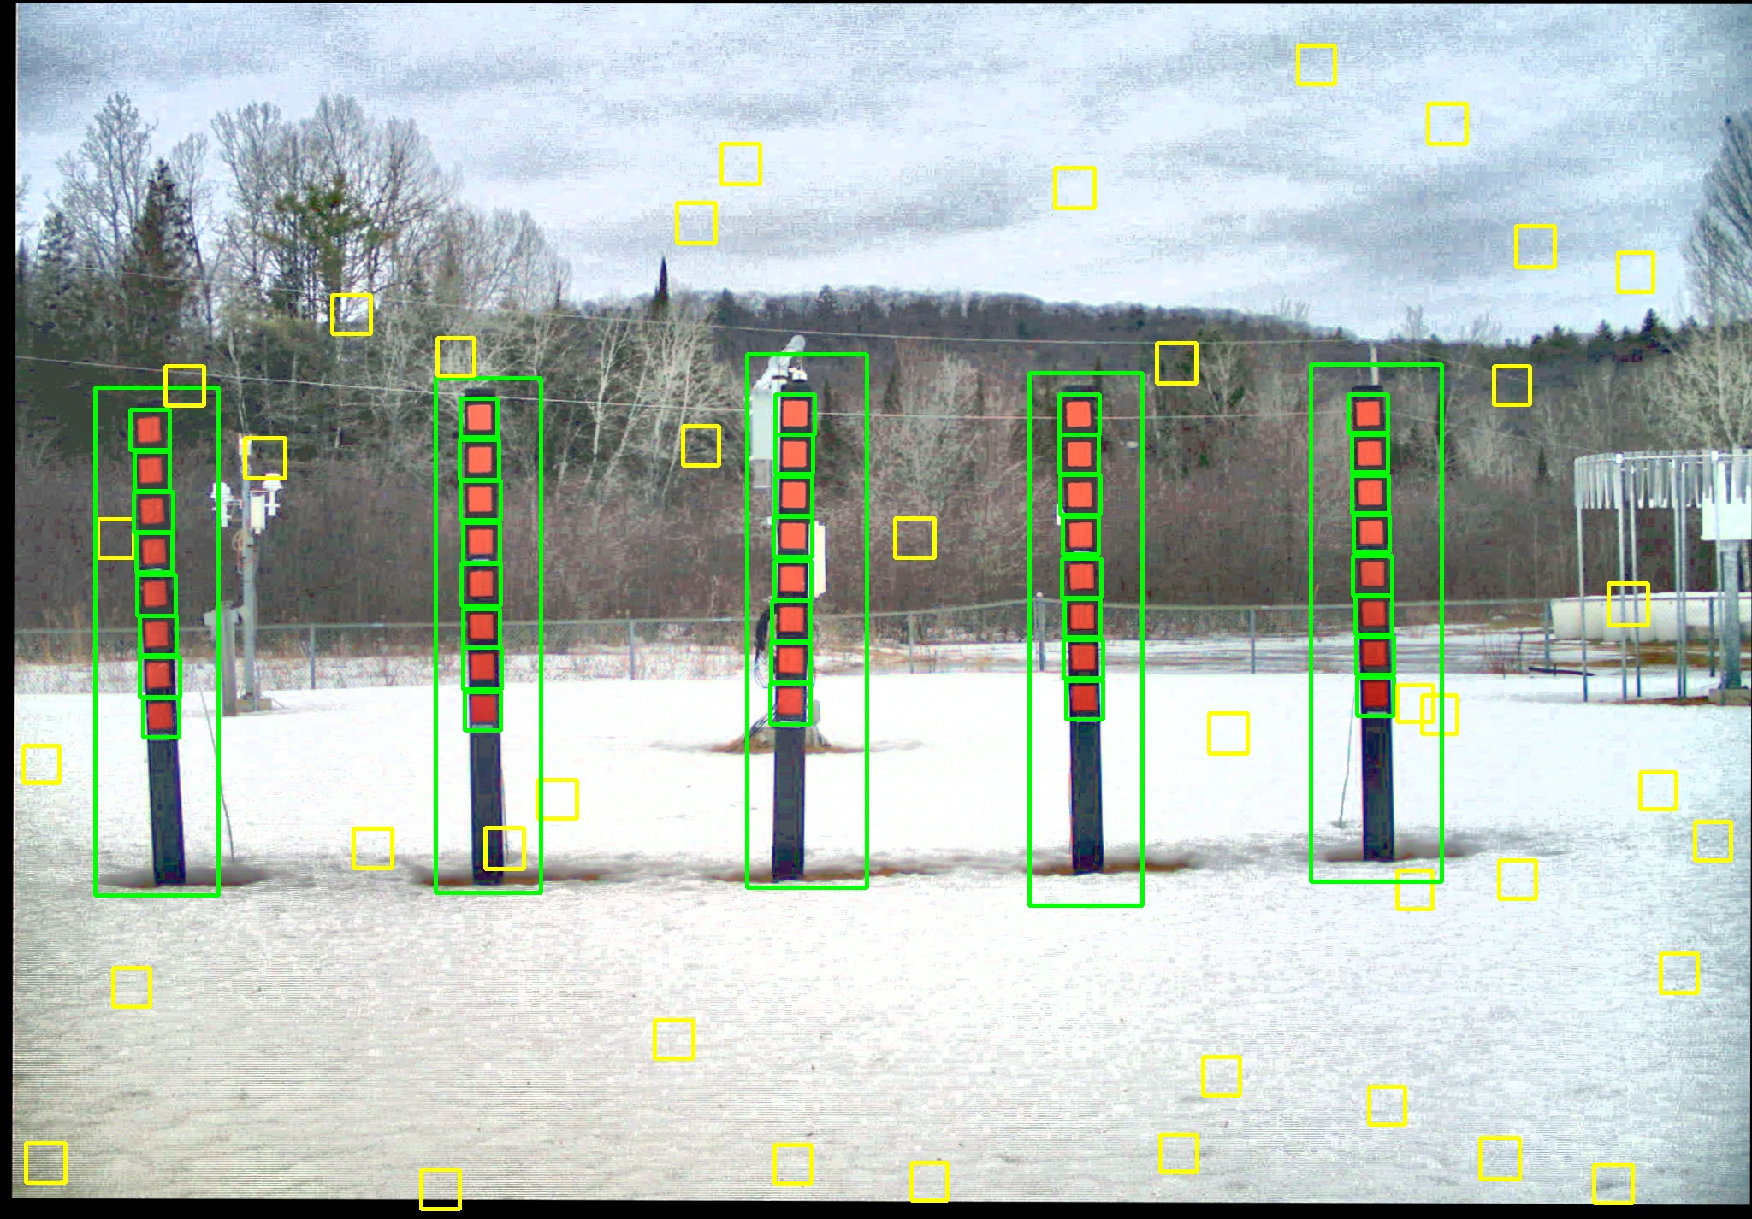
Stake Verification
Stakes must be checked before the snow depth can be measured
Using ROI from template, blob presence is confirmed
Two or more blobs for valid stake
Blob verification based off size of contour in HSV filtered image
Deep learning model is dynamically trained (yellow)

Slide 9
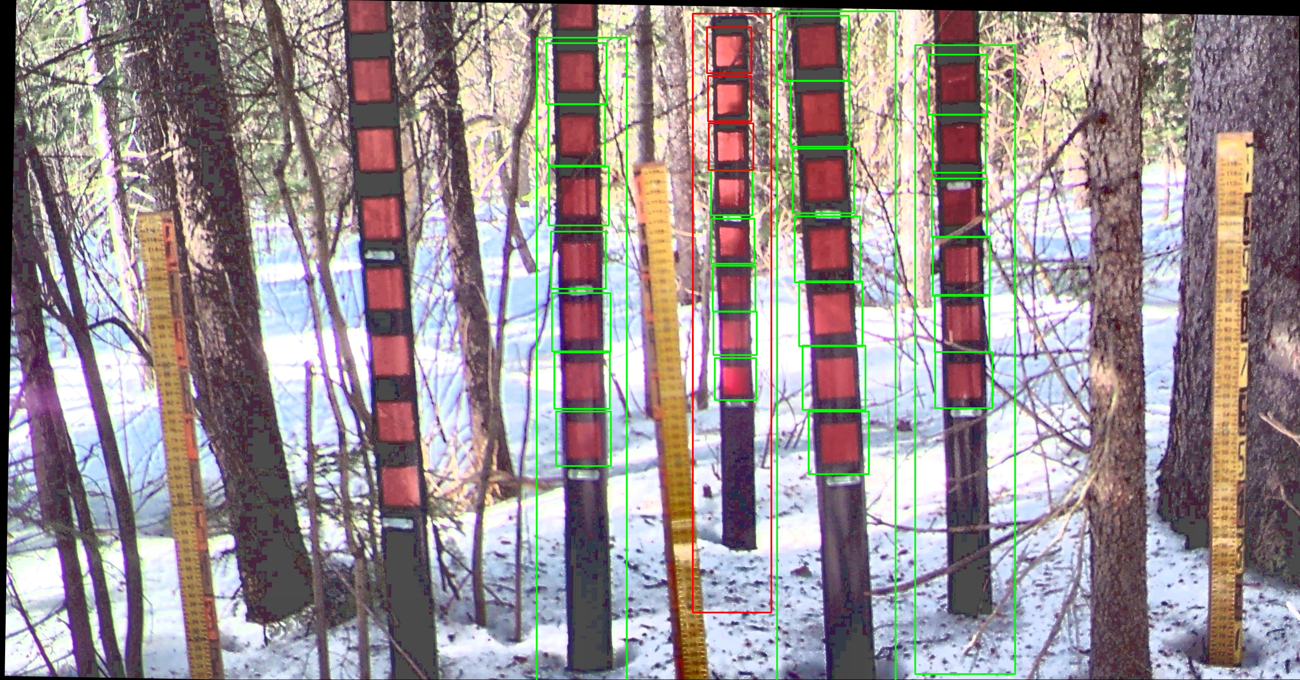
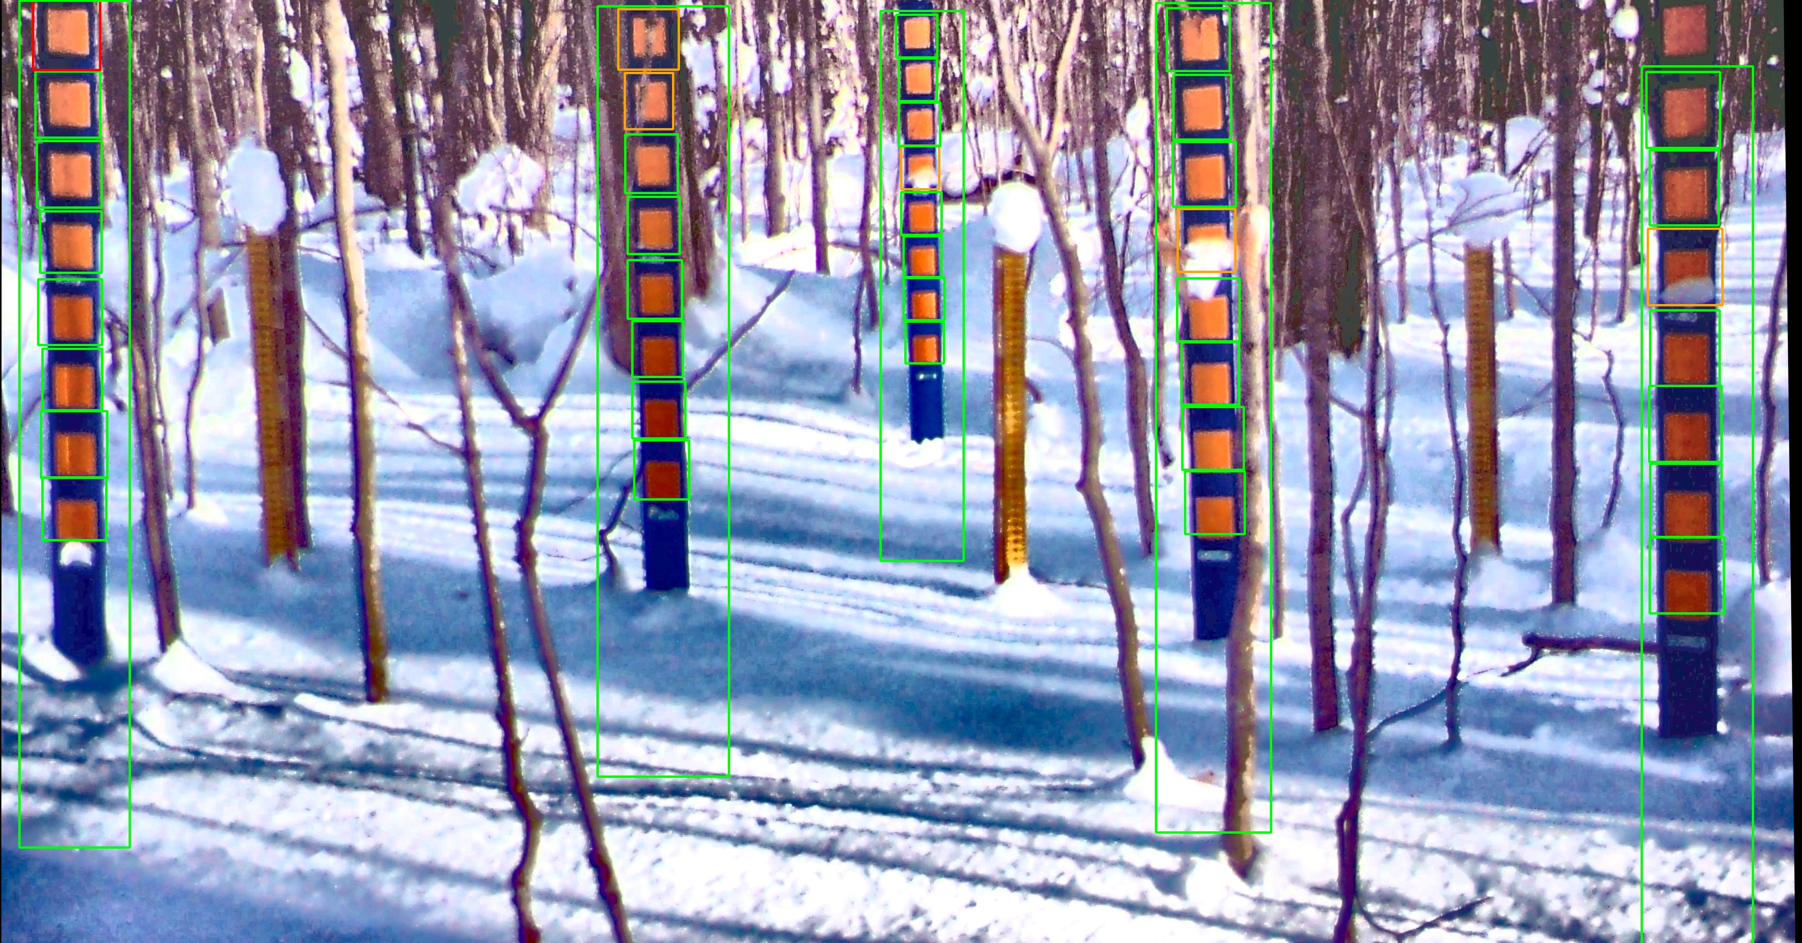
Stake Verification
Invalid
Limitation of using HSV filter
Valid (Deep Learning)
Blob recovered by neural network
Cannot be used for tensor calculation
Template coordinates are used for intersection
Valid
Coordinates of blob will be used for tensor calculation and intersection

Slide 10
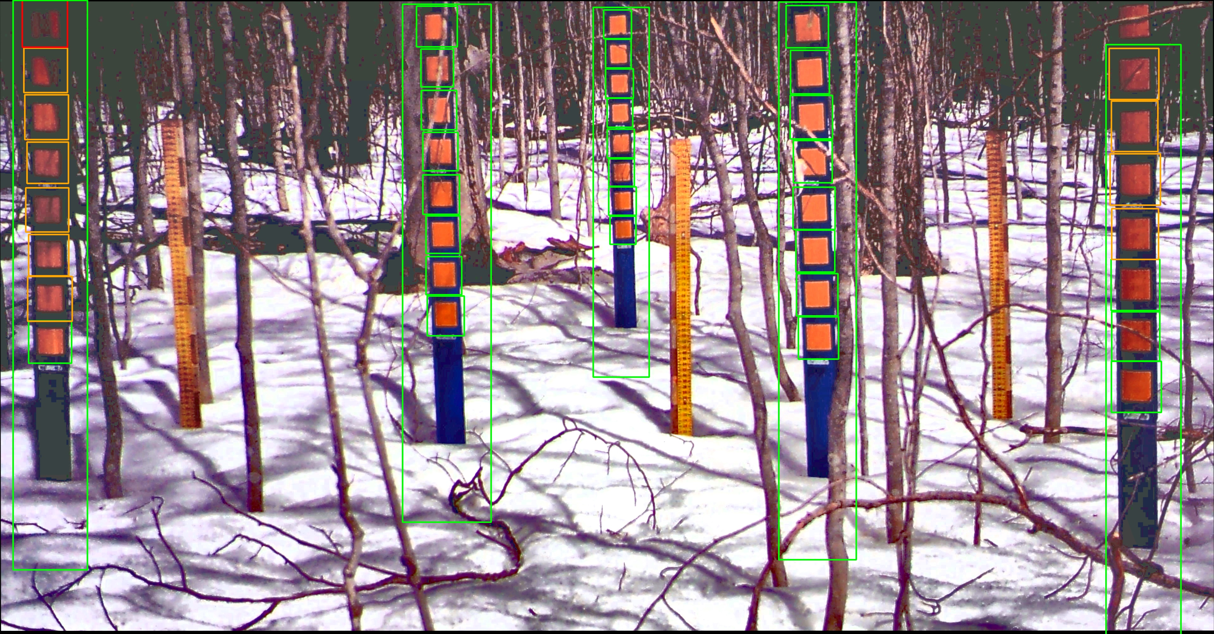
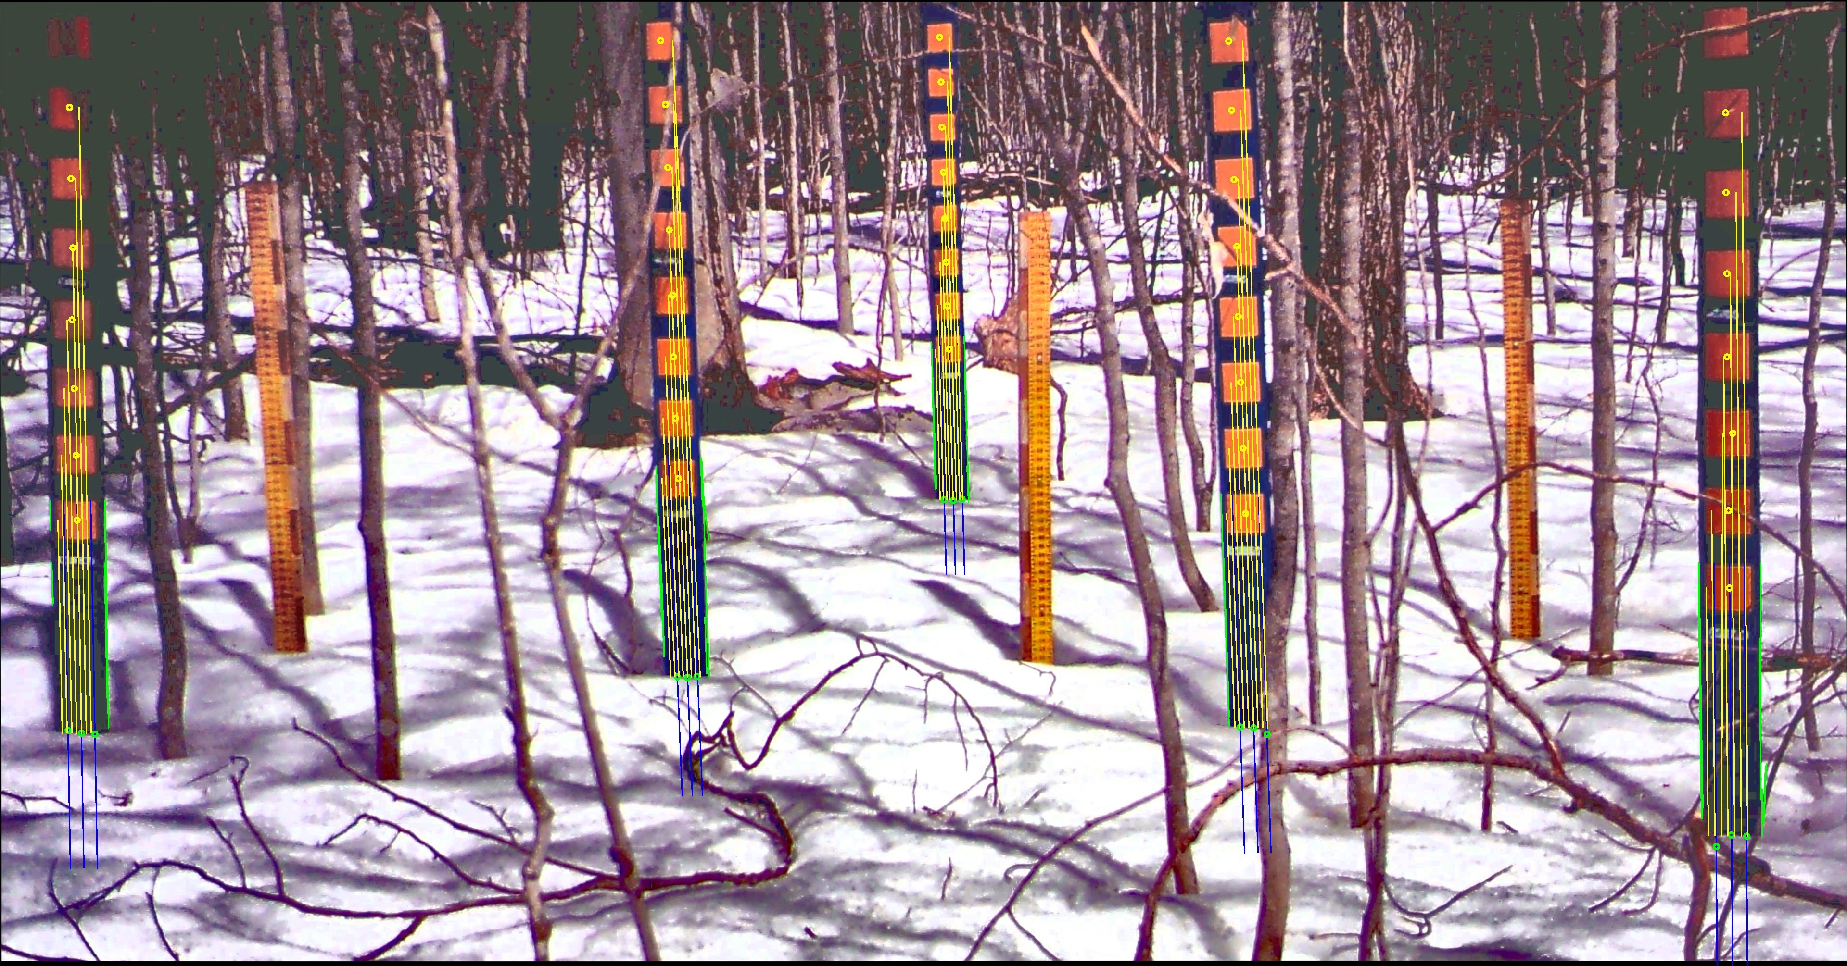
Stake Verification

Slide 11
Intersection
Three lines fitted to each stake
Intensity signal along each line is processed
Edge detection to improve accuracy
Distance from blob to snow intersection used as secondary measurement (yellow lines)

Slide 12
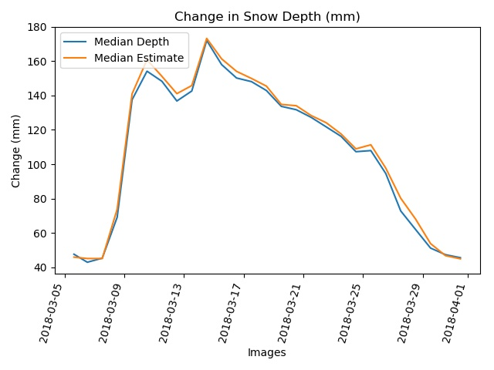
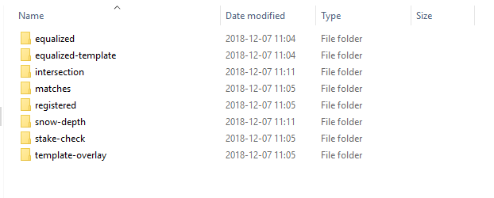
Output
Excel spreadsheet
PDF image summary
PDF run summary
Snow depth graph (left)

Slide 13
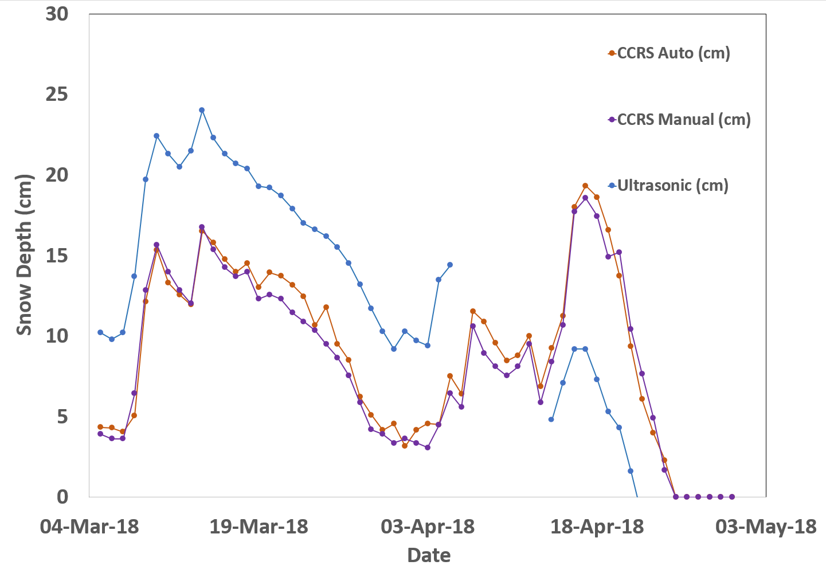
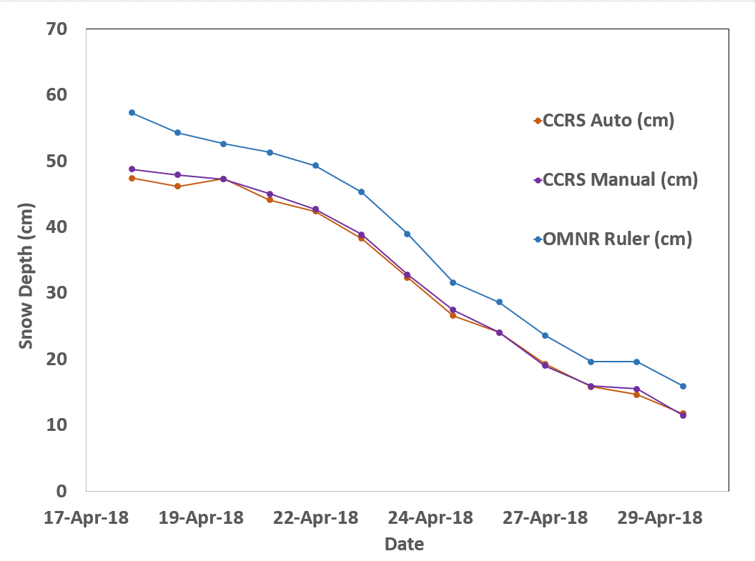
Intercomparison

